Slide 1
Voc V-2.0 Voice of citizen
Project Seminar Phase-1
Under Guidance of:
Mr Sayeesh
Project Guide/Mentor
Presented by:
Imran Khan-4AL16CS040
Vignesh Shetty-4AL16CS124
Manish B Shriyan-4AL16CS131
Vighnesh Pejathaya-4AL16CS060

Slide 2
Content
Problem Statement.
Objectives.
Existing System.
Proposed System.
Flow Chart.
Architectural Design.
Requirements.
Methodology.

Slide 3
PROBLEM STATEMENT:
The main objective of this project is to help people to raise their voice against the difficulties faced by them in day to day life, through the app. The issue may be related to water leakage, sewage, road or street light maintenance etc.
Once the higher authorities know about an issue, they send the information to concerned people for further action.
With the help of the app, the status of the complaint will be tracked by the registered people. Once the issue has been solved completely, the concerned person will update the status of the issue, with the acknowledgement to the applicant and higher authorities.

Slide 4
Objectives:
Using this system the citizen can just complain wherever the problem is raised instead of going to panchayath and registering complaint. The panchayath authorities can directly login and access the complaints from citizen and update status.
The application also includes various features such as the citizen can take a picture and upload location of the place where there is a problem instead of uploading from the gallery.

Slide 5
Existing system:
E-panchayath provides online web service to the people living in their area. All the services which were done manually are made online in the project.
The existing mobile app automatically specifies the exact location without the user intervention.
The photos picked from the gallery or google photos could not be uploaded in the application because its image uploading feature enables the user to send only the snap shot which was captured on the spot.
Once the issue has been solved completely, the concerned person will update status of the issue, with the acknowledgement to the people and higher authorities. The same status will be updated in the app and complaint will be cleared.

Slide 6
Registration:
Login:
About Panchayath :
Edit Profile:
Delete Profile:
Register Complaint:
Track Complaints:

Slide 7
Proposed system
UI with Kannada Text.
Info, description about Development committee and Notifications.
Information of Ward Development Activities Under taken .
User Interface for friendly and easy Interaction.
Deployment.

Slide 8
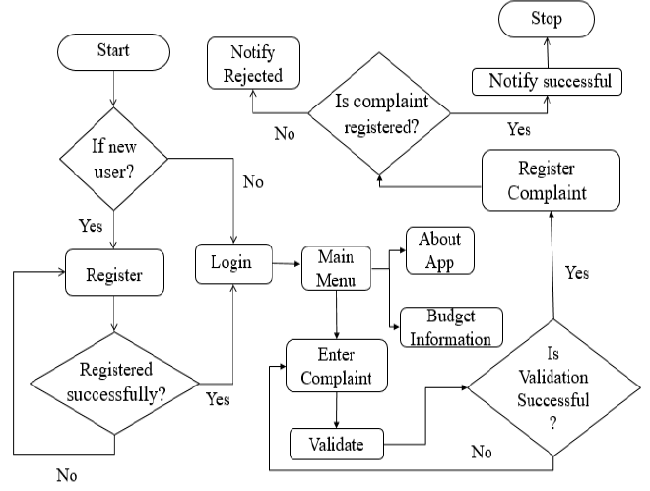
Flow chart:

Slide 9
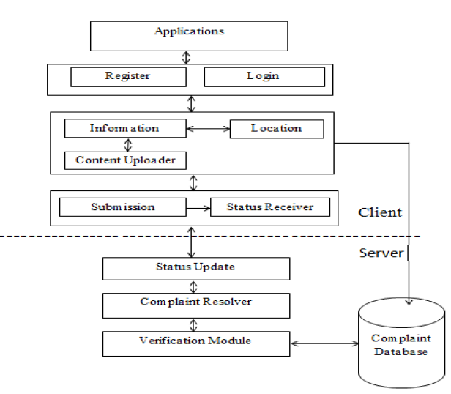
Architectural Design:

Slide 10
Requirements:
User Interface
User interaction with an application is required to register and to login. The user has to login to the application by entering his email and password. This is achieved through interactive and user friendly GUI. This provides user interface with several option like to register complaint, track complaint details.

Slide 11
Hardware Interface
8GB RAM
Android device
1.5GHz Intel i5 processor
Software Interface
Operating system: android, windows
Programming languages: PHP, Java, XML, SQL
Tools: Android studio, Xampp, Chrome or Mozilla browser

Slide 12

Methodology:

Slide 13
Reference:
Zhilong Yang, Yong Wang, Yongquan Yang and Zhiqiang Wei. “Research and Design of a Real-time Interactive Application Development Model Based on the Android Platform”. Proc of IEEE. 2013. pp 132-135.
Bhuvana Sekar and Jiang B.Liu. “Location Based Mobile Apps Development on Android Platform” . Proc of IEEE. 2014. pp 2148-2153.

Slide 14
Thank you

